Slide 1
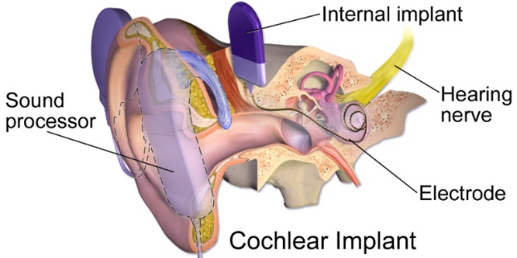
Measuring the impact of subsidy decision on bilateral cochlear implants for children with severe-to-profound sensorineural hearing loss in Singapore Xue Shi LUO^{1@}, Louise GOH¹, Hansen SUN¹, Kwong NG¹ ¹Agency for Care Effectiveness (ACE), Ministry of Health, Singapore, @LUO_Xue_Shi@moh.gov.sg
❶
❷
BACKGROUND
METHODS
The Agency for Care Effectiveness performs health technology assessments (HTA) in Singapore.
Following the evaluations, it is vital to evaluate the impact of subsidy decisions resulting from HTA and its technology guidance.
Using the bilateral cochlear implants for children with severe-to-profound sensorineural hearing loss as a case study, we examined real-world data to answer two questions:
Manual reporting by public hospitals using a standardised template was initiated in 2018 as utilisation data were not readily available.
The public hospitals submitted data on a half-yearly basis and to date, we completed six rounds of data collection.
The reported data were then linked with the clinical encounter and claims database for validation and extraction of additional information (e.g. patient demographics).
Data clarifications were sought from public hospitals where necessary.
The key findings were then used to inform the Medical Technology Advisory Committee.
1. How has utilisation changed from pre- to post-guidance?
2. What is the extent of guidance adoption in terms of indications for subsidy and pricing guidelines?
❸
❹
RESULTS
CONCLUSION
The total number of children patients who have undergone cochlear implantation has increased over the years (Figure 1).
All patients in the post-guidance period fulfilled the recommended clinical criteria.
Due to challenges in accessing billing data, appropriateness of subsidy extension was only assessed in the second year; all 29 eligible patients received subsidy.
We also found that pricing guidelines (i.e. lower procurement prices and margins) were well-adopted by the public hospitals.
Figure 1: Pre- and post-guidance number of children patients
The subsidy has benefited 52 unique patients in the two years post-guidance.
We measured the impact of subsidy decision for cochlear implants despite constraints in data accessibility; real-world data were manually collected in the absence of an implant registry or database, which may become unsustainable as more implants are evaluated.
www.ACE-HTA.gov.sg

